Slide 1

CORONA VIRUS ANALYSIS
Internship project
Batch : MIP-DA-07
Masanam Suraj

Slide 2
Table of content
Problem statement
Dataset overview
Introduction
Dataset explanation
Data exploration using SQL

Slide 3
Introduction
The CORONA VIRUS are a family of viruses that causes respiratory diseases or gastrointestinal diseases. This VIRUS pandemic has had a significant impact on public health and has created an urgent need for data-driven insights to understand the spread of the virus
In this project, I analysed a COVID -19 dataset using SQL and data analysis skills to uncover valuable insights.the dataset included information such as geographical location,dates, confirmed cases,deaths,and recoveries. My analysis was guided by a set of 16 insightful questions provided in the project guidelines, aiming to extract meaningful conclusions from the data

Slide 4

Problem statement
The CORONA VIRUS pandemic has had a significant impact on public health and has created an urgent need for data-driven insights to understand the spread of the virus. This analysis uses SQL to showcase the key insights of its spread globally in year 2020&2021

Slide 5
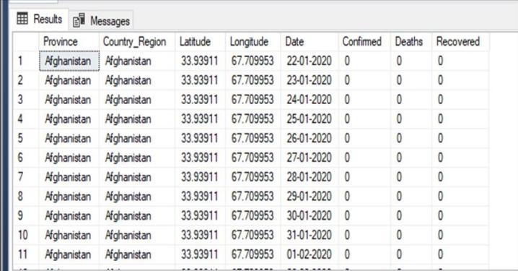
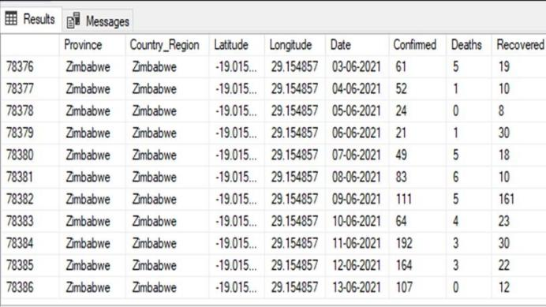
Dataset overview

Slide 6

Dataset explanation
Province : geographic subdivision within a country/region
Country/region : geographic entity where data is recorded
Latitude : north-south postion on Earth’s surface
Longitude : East-west position on Earth’s surface
Date : recorded date of corona virus data
Confirmed : number of diagnosed corona virus cases
Deaths : number of corona virus related deaths
Recovered : number of recovered corona virus cases

Slide 7
Data exploration using SQL

Slide 8
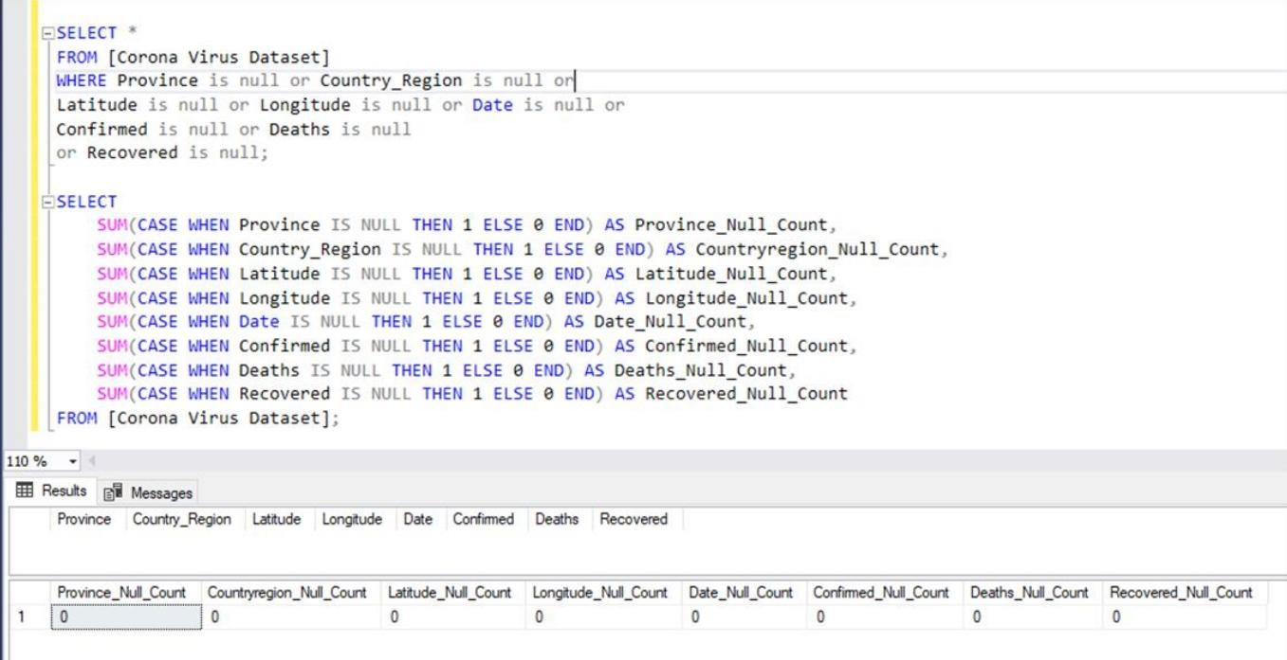
1.code to check null values

Slide 9
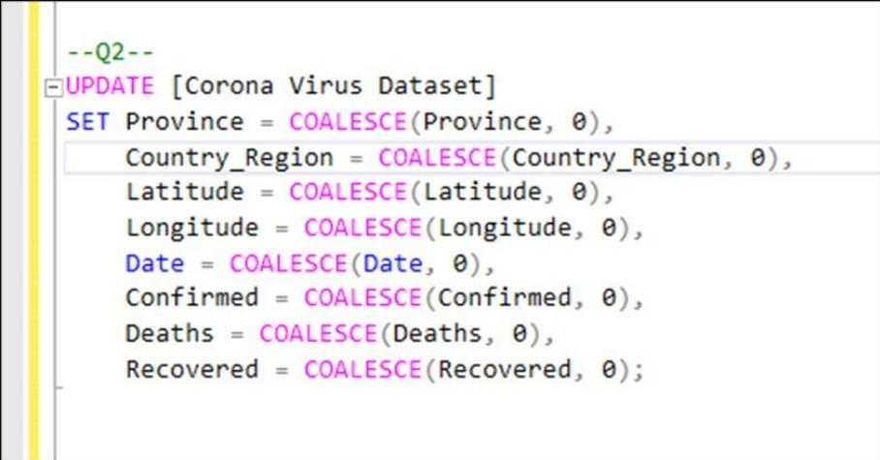
2.Updating them with zeros for all columns
Query :
Output :
Output :

Slide 10
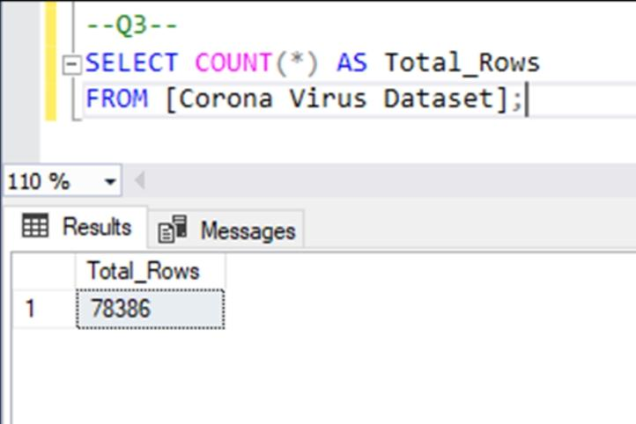
3. Total number of rows

Slide 11
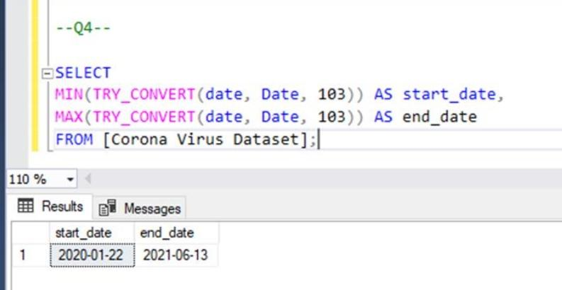
4. Start date and end date
Start date
2020/01/22
End date
2021/06/13

Slide 12
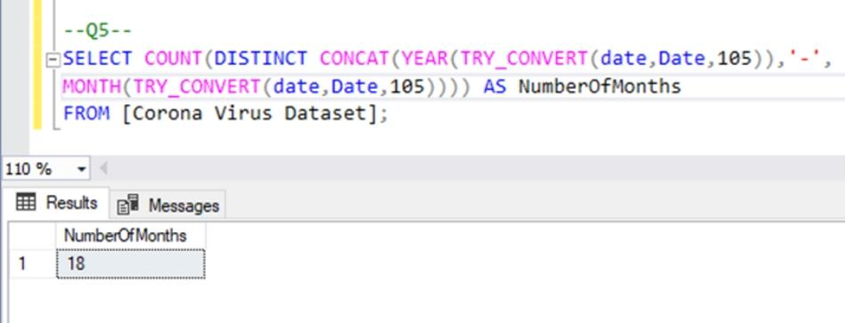
5. Number of month present in dataset

Slide 13
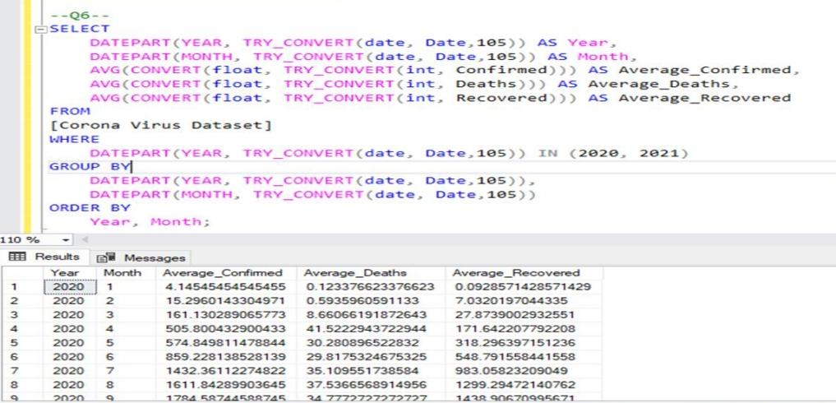
6. Month average of confirmed, deaths and recovered

Slide 14
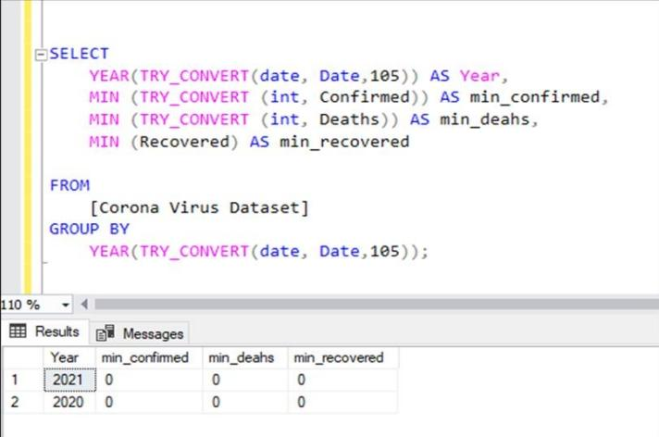
Q . Minimum value per year

Slide 15
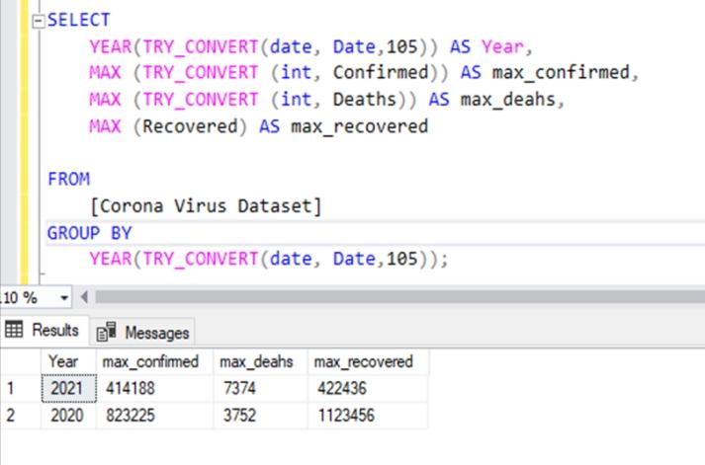
Q . Maximum value per year

Slide 16
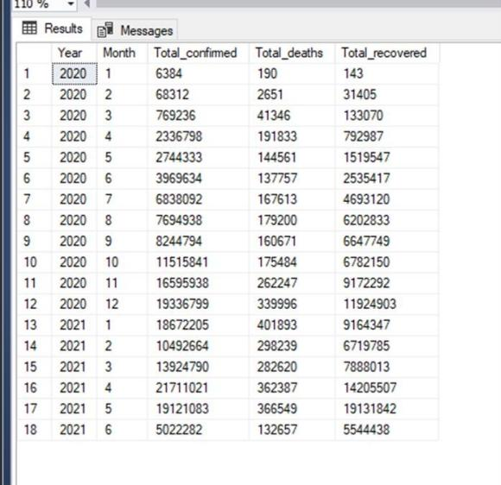
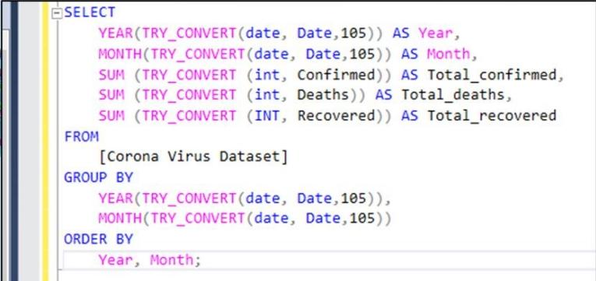
Q. Total number of cases in each month

Slide 17
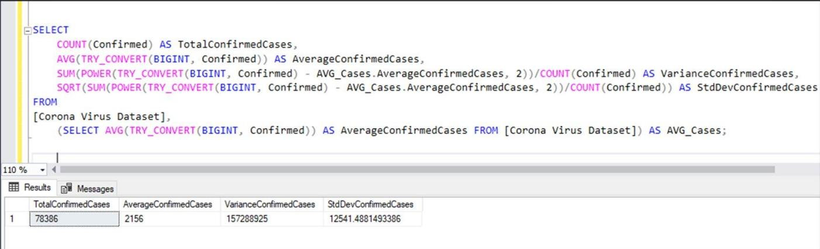
Q. Corona virus spread out with respect to death case per month

Slide 18
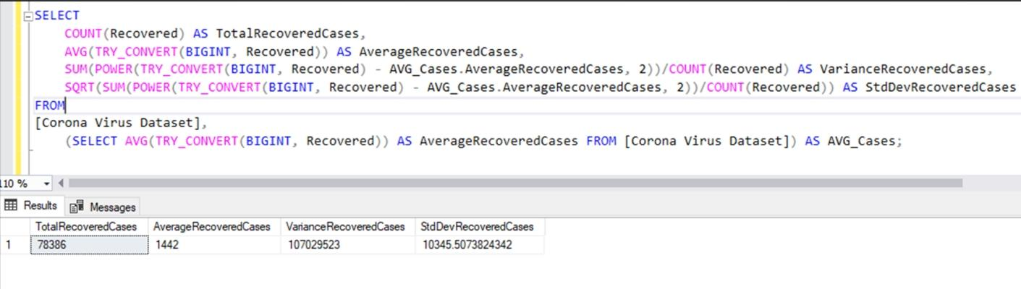
Q. Virus spread with respect to recovered cases

Slide 19
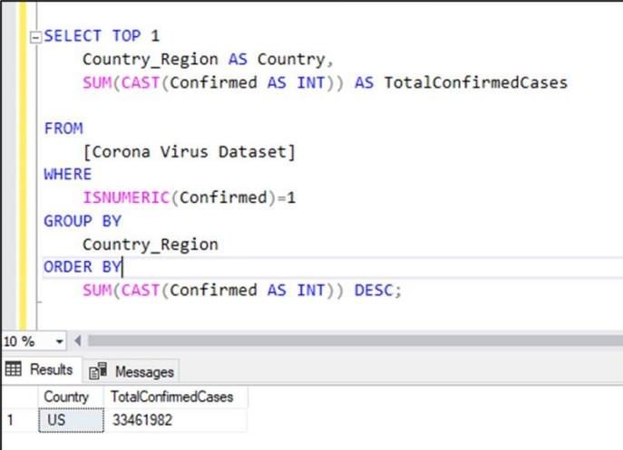

Q. Country having highest number of confirmed cases
USA

Slide 20
Q. Country having lowest number of death cases

Slide 21
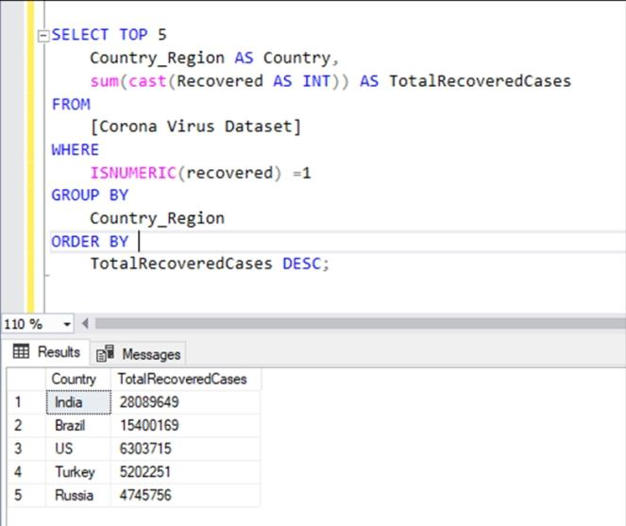
Q. Top five countries having highest recovered cases
India
Brazil
Us
Turkey
Russia

Slide 22


